Slide 1
8.1 Programming
Procedures, functions and parameters

Slide 2
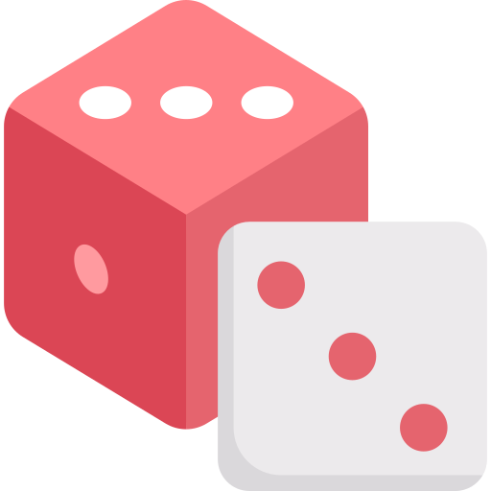
Procedures and functions
def roll_a_dice():
#Roll a dice
return random.randint(1,6)
def order_dice(d1, d2):
#Change the order of the dice to highest value first
#and join the values together
if d1 >= d2:
return int(d1 + d2)
else:
return int(d2 + d1)
def output_throw():
#Output the results of the two dice thrown
dice1 = 0
dice2 = 0
while dice1 == dice2:
dice1 = str(roll_a_dice())
dice2 = str(roll_a_dice())
print("Dice 1:", dice1)
print("Dice 2:", dice2)
roll = order_dice(dice1, dice2)
return roll
#Main program
#This tool outputs the value of two dice
import random
print(output_throw())
There are two main types of sub-program.
Procedures
Carry out a task.
Provide structure to code.
Functions
Carry out a task and return a value.
Create reusable program components.

Slide 3
Procedures and functions
def roll_a_dice():
#Roll a dice
return random.randint(1,6)
def order_dice(d1, d2):
#Change the order of the dice to highest value first
#and join the values together
if d1 >= d2:
return int(d1 + d2)
else:
return int(d2 + d1)
def output_throw():
#Output the results of the two dice thrown
dice1 = 0
dice2 = 0
while dice1 == dice2:
dice1 = str(roll_a_dice())
dice2 = str(roll_a_dice())
print("Dice 1:", dice1)
print("Dice 2:", dice2)
roll = order_dice(dice1, dice2)
return roll
#Main program
#This tool outputs the value of two dice
import random
print(output_throw())
In this program, the code actually starts at the bottom of the code listing.

Slide 4
Procedures and functions
def roll_a_dice():
#Roll a dice
return random.randint(1,6)
def order_dice(d1, d2):
#Change the order of the dice to highest value first
#and join the values together
if d1 >= d2:
return int(d1 + d2)
else:
return int(d2 + d1)
def output_throw():
#Output the results of the two dice thrown
dice1 = 0
dice2 = 0
while dice1 == dice2:
dice1 = str(roll_a_dice())
dice2 = str(roll_a_dice())
print("Dice 1:", dice1)
print("Dice 2:", dice2)
roll = order_dice(dice1, dice2)
return roll
#Main program
#This tool outputs the value of two dice
import random
print(output_throw())
It calls output_throw(), so the program jumps and executes the code from here.

Slide 5
Procedures and functions
def roll_a_dice():
#Roll a dice
return random.randint(1,6)
def order_dice(d1, d2):
#Change the order of the dice to highest value first
#and join the values together
if d1 >= d2:
return int(d1 + d2)
else:
return int(d2 + d1)
def output_throw():
#Output the results of the two dice thrown
dice1 = 0
dice2 = 0
while dice1 == dice2:
dice1 = str(roll_a_dice())
dice2 = str(roll_a_dice())
print("Dice 1:", dice1)
print("Dice 2:", dice2)
roll = order_dice(dice1, dice2)
return roll
#Main program
#This tool outputs the value of two dice
import random
print(output_throw())
It calls output_throw(), so the program jumps and executes the code from here.
When the sub-program ends, it returns a value – this means output_throw() is a function.

Slide 6
Procedures and functions
def roll_a_dice():
#Roll a dice
return random.randint(1,6)
def order_dice(d1, d2):
#Change the order of the dice to highest value first
#and join the values together
if d1 >= d2:
return int(d1 + d2)
else:
return int(d2 + d1)
def output_throw():
#Output the results of the two dice thrown
dice1 = 0
dice2 = 0
while dice1 == dice2:
dice1 = str(roll_a_dice())
dice2 = str(roll_a_dice())
print("Dice 1:", dice1)
print("Dice 2:", dice2)
roll = order_dice(dice1, dice2)
return roll
#Main program
#This tool outputs the value of two dice
import random
print(output_throw())
The output_throw() function also calls another sub-program, roll_a_dice(), which returns a random number from 1 to 6.
That makes roll_a_dice another function.

Slide 7
Procedures and functions
def roll_a_dice():
#Roll a dice
return random.randint(1,6)
def order_dice(d1, d2):
#Change the order of the dice to highest value first
#and join the values together
if d1 >= d2:
return int(d1 + d2)
else:
return int(d2 + d1)
def output_throw():
#Output the results of the two dice thrown
dice1 = 0
dice2 = 0
while dice1 == dice2:
dice1 = str(roll_a_dice())
dice2 = str(roll_a_dice())
print("Dice 1:", dice1)
print("Dice 2:", dice2)
roll = order_dice(dice1, dice2)
return roll
#Main program
#This tool outputs the value of two dice
import random
print(output_throw())
The output_throw() function also calls another sub-program, order_dice().
The order_dice() sub-program returns the values of the two dice, largest value first, making it yet another function.

Slide 8
Procedures and functions
def roll_a_dice():
#Roll a dice
return random.randint(1,6)
def order_dice(d1, d2):
#Change the order of the dice to highest value first
#and join the values together
if d1 >= d2:
return int(d1 + d2)
else:
return int(d2 + d1)
def output_throw():
#Output the results of the two dice thrown
dice1 = 0
dice2 = 0
while dice1 == dice2:
dice1 = str(roll_a_dice())
dice2 = str(roll_a_dice())
print("Dice 1:", dice1)
print("Dice 2:", dice2)
roll = order_dice(dice1, dice2)
return roll
#Main program
#This tool outputs the value of two dice
import random
print(output_throw())
Advantages of sub-programs
Programs are easier to write and debug.
Components can be easily reused.
Functions can be stored in a library for easy reuse across multiple programs.

Slide 9
Procedures and functions
def roll_a_dice():
#Roll a dice
return random.randint(1,6)
def order_dice(d1, d2):
#Change the order of the dice to highest value first
#and join the values together
if d1 >= d2:
return int(d1 + d2)
else:
return int(d2 + d1)
def output_throw():
#Output the results of the two dice thrown
dice1 = 0
dice2 = 0
while dice1 == dice2:
dice1 = str(roll_a_dice())
dice2 = str(roll_a_dice())
print("Dice 1:", dice1)
print("Dice 2:", dice2)
roll = order_dice(dice1, dice2)
return roll
#Main program
#This tool outputs the value of two dice
import random
print(output_throw())
Advantages of sub-programs
Programs are easier to write and debug.
Components can be easily reused.
Functions can be stored in a library for easy reuse across multiple programs.
For example, import random imports the random library of functions into a program.
Programs are also easier to test.

Slide 10
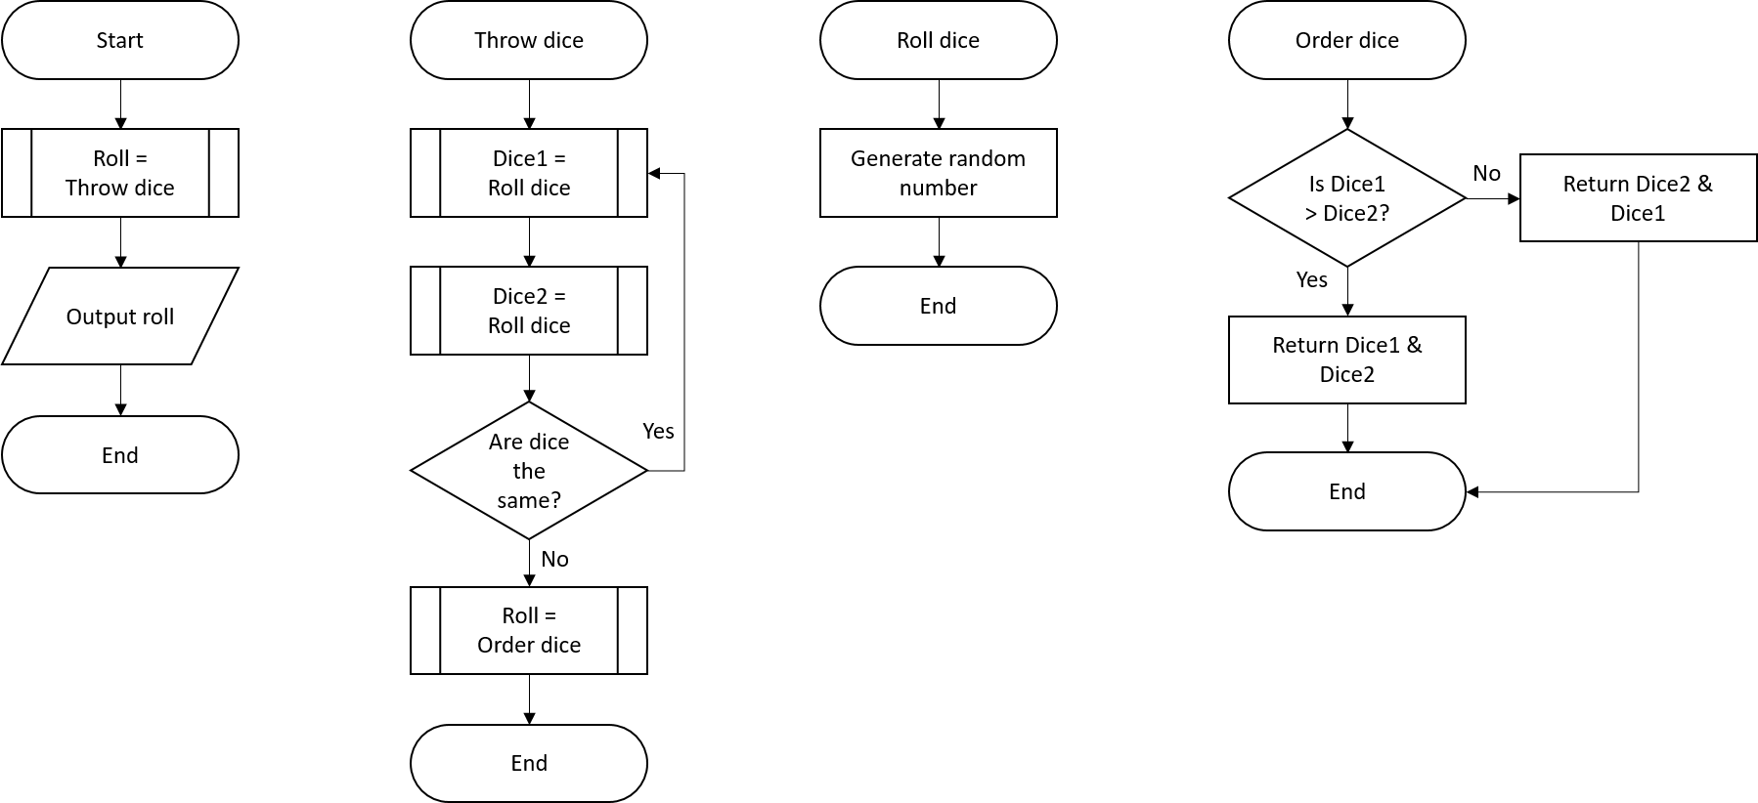
Procedures and functions
Here we can see how sub-programs are called from inside flowcharts.

Slide 11
Cambridge IGCSE pseudocode
Here is an example of how these concepts will look in exam papers following the Cambridge IGCSE pseudocode format, which is listed towards the back of the syllabus.
A procedure with no parameters:
PROCEDURE <identifier>
<statements>
ENDPROCEDURE
A procedure with parameters:
PROCEDURE <identifier> (<param1>:<datatype>, <param2>:<datatype> ...)
<statements>
ENDPROCEDURE
Procedures should be called as follows:
CALL <identifier>
CALL <identifier>(Value1, Value2 ...)
Procedures

Slide 12
Cambridge IGCSE pseudocode
Here is an example of how these concepts will look in exam papers following the Cambridge IGCSE pseudocode format, which is listed towards the back of the syllabus.
PROCEDURE Default Line
CALL LINE(60)
ENDPROCEDURE
PROCEDURE Line(Size : INTEGER)
DECLARE Length : INTEGER
FOR Length ß 1 TO Size
OUTPUT '-'
NEXT Length
ENDPROCEDURE
IF MySize = Default
THEN
CALL DefaultLine
ELSE
CALL Line(MySize)
ENDIF
Procedures

Slide 13
Cambridge IGCSE pseudocode
Here is an example of how these concepts will look in exam papers following the Cambridge IGCSE pseudocode format, which is listed towards the back of the syllabus.
A function with no parameters:
FUNCTION <identifier> RETURNS <data type>
<statements>
ENDFUNCTION
A function with parameters:
FUNCTION <identifier> (<param1>:<datatype>, <param2>:<datatype> ...) RETURNS <data type>
<statements>
ENDFUNCTION
The keyword CALL should not be used when calling a function.
Functions should only be called as part of an expression.
When the RETURN statement is executed, the value returned replaces the function call in the expression and the expression is then evaluated.
Functions

Slide 14
Cambridge IGCSE pseudocode
Here is an example of how these concepts will look in exam papers following the Cambridge IGCSE pseudocode format, which is listed towards the back of the syllabus.
FUNCTION SumSquare(Number1:INTEGER, Number2:INTEGER) RETURNS INTEGER
RETURN (Number1 * Number1) + (Number2 * Number2)
ENDFUNCTION
OUTPUT "Sum of squares = ", SumSquare(10, 20)
Functions

Slide 15

Procedures and functions
Larger programs are developed as a set of subroutines or sub-programs.
Structuring code using sub-programs makes it easier to read and debug.
Functions return values and create reusable program components.
Procedures structure a program in a modular way, making it easier to read.
Each sub-program can be tested independently.
Sub-programs can be saved in libraries and reused in other programs.

Slide 16


